Slide 1
Digital Control

Slide 2
DC
Many real-time systems are embedded in sensors and actuators and function as digital controllers.
State of the plant is monitored by sensors and can be changed by actuators.
The RTS estimates from the sensor readings the current state of the plant and computes a control output based on the difference between the current state and the desired state which is known as control-law computation.

Slide 3
Sampled Data System
Common approach to designing a digital controller is to
1) Start with an analog controller.
2) Analog version is then transformed into a digital version and resultant controller is a sampled data system.
3)It performs control-law computation every period.
4) Digital outputs is then converted back to an analog form needed to activate the actuators.

Slide 4
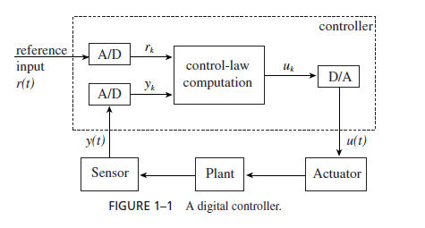

Slide 5
y(t) - Measured state of the plant at time t.
r (t) – Desired State of the plant at time t.
e(t) = r (t) − y(t)
denote the difference between the desired state r (t) and the measured state y(t) at time t .
The output u(t) consists of three terms:
1) Term that is proportional to e(t),
2) Term that is proportional to the integral of e(t)
3) Term that is proportional to the derivative of e(t).

Slide 6
Procedure
Set timer to interrupt periodically with period T ;
At each timer interrupt, do
do analog-to-digital conversion to get y;
compute control output u;
output u and do digital-to-analog conversion;
End do;

Slide 7
We assume that the system provides a timer. Once set by the program, the timer generates an interrupt every T units of time until its setting is cancelled.
Selection of Sampling Period:
The length T of time between any two consecutive
instants at which y(t) and r (t) are sampled is called the sampling period.
Behavior of the resultant digital controller critically depends on this parameter.

Slide 8
Small sampling period means more frequent control-law computation and higher processor-time demand.
Selection of sampling period can be achieved by two factors:
A) Perceived responsiveness of overall system.
B) Dynamic behavior of the plant.

Slide 9
Multirate Systems
A plant typically has more than one degree of freedom. Its state is defined by multiple state variables (e.g., the rotation speed, temperature, etc. of an engine or the tension and position of a video tape). Therefore, it is monitored by multiple sensors and controlled by multiple actuators. We can think of a multivariate (i.e., multi-input/multi-output) controller.

Slide 10
different state variables may have different dynamics, the sampling periods required to achieve smooth responses.
For example, because the rotation speed of a engine changes faster than its temperature, the required sampling rate for RPM (Rotation Per Minute) control is higher than that for the temperature control.

Slide 11
Timing Characteristics
The workload generated by each multivariate, multirate digital controller consists of a few periodic
control-law computations. Their periods range from a few milliseconds to a few seconds, and some of them are continuous by nature and others are computed only when requested by the operator.

